Slide 1
2022 Lockheed Martin Falcon Challenger
Emergency Landing
Algorithm : Mission Summary
Final-Round presentation
Korea Aerospace University

Slide 2
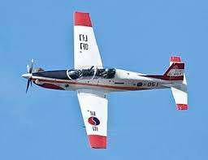

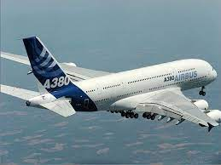



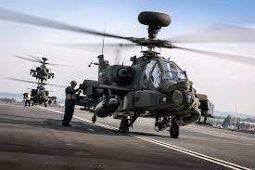

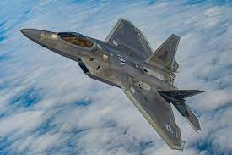

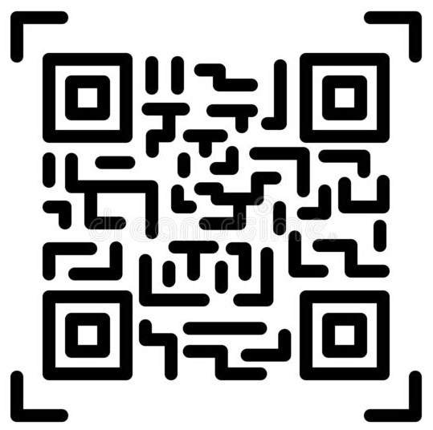
1. Flag Recognition Course
2. Tracking Course
3. Landing Course
KT-1
A380
AH-64
Apache
F22

Slide 3
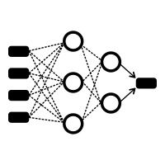
Mission Solution
1. Flag Recognition Course
2. Tracking Course
3. Landing Course
Step1. QR Dectection
Opencv qr detector
Pyzbar module
Step2. Flag Recognition
Opencv blob detector
Yolov5 (handwriting)
Use yolov5 model
Tracking by PD(box size)
Use yolov5 model

Slide 4

1. Flag Recognition Course
Step1. QR Dectection
Step2. Flag Recognition

Slide 5

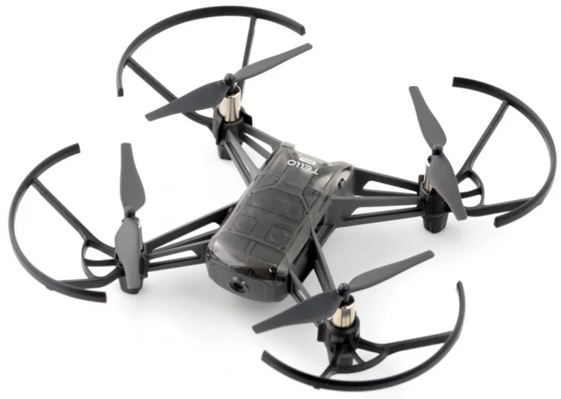
1. Flag Recognition Course
Step1. QR Dectection
Drone hovers for 5 seconds

Slide 6
1. Flag Recognition Course
Step2. Flag Recognition
Circle Detected!

Slide 7
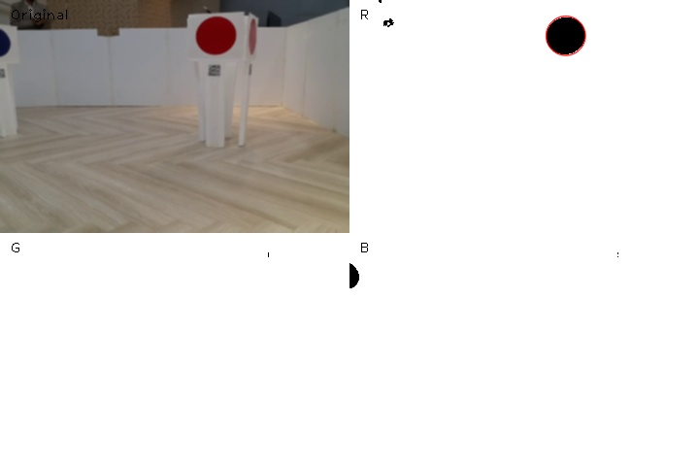
1. Flag Recognition Course
Step2. Flag Recognition
def clr_bin( ) -> Binary(Black and White) color filter
def blob( ) -> Circle looks like a dot from a distance
def circle_follow( ) , def circle_bin_detection( )
class yolo -> def detect_letter( )

Slide 8
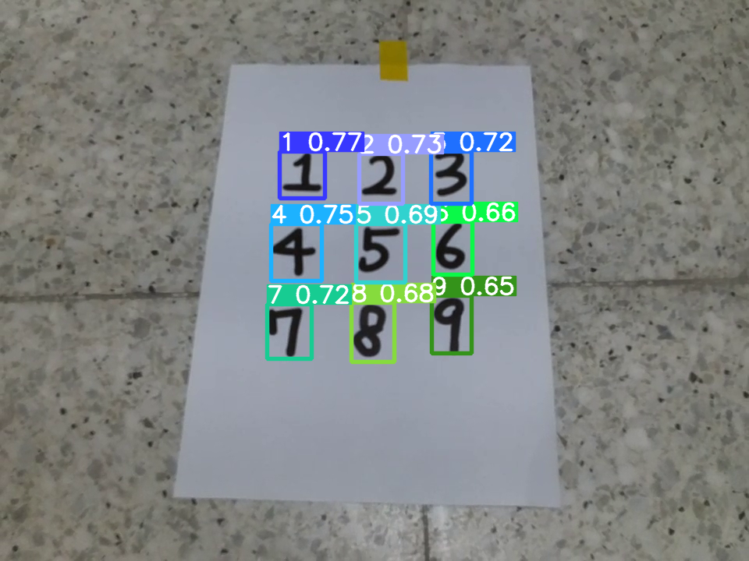
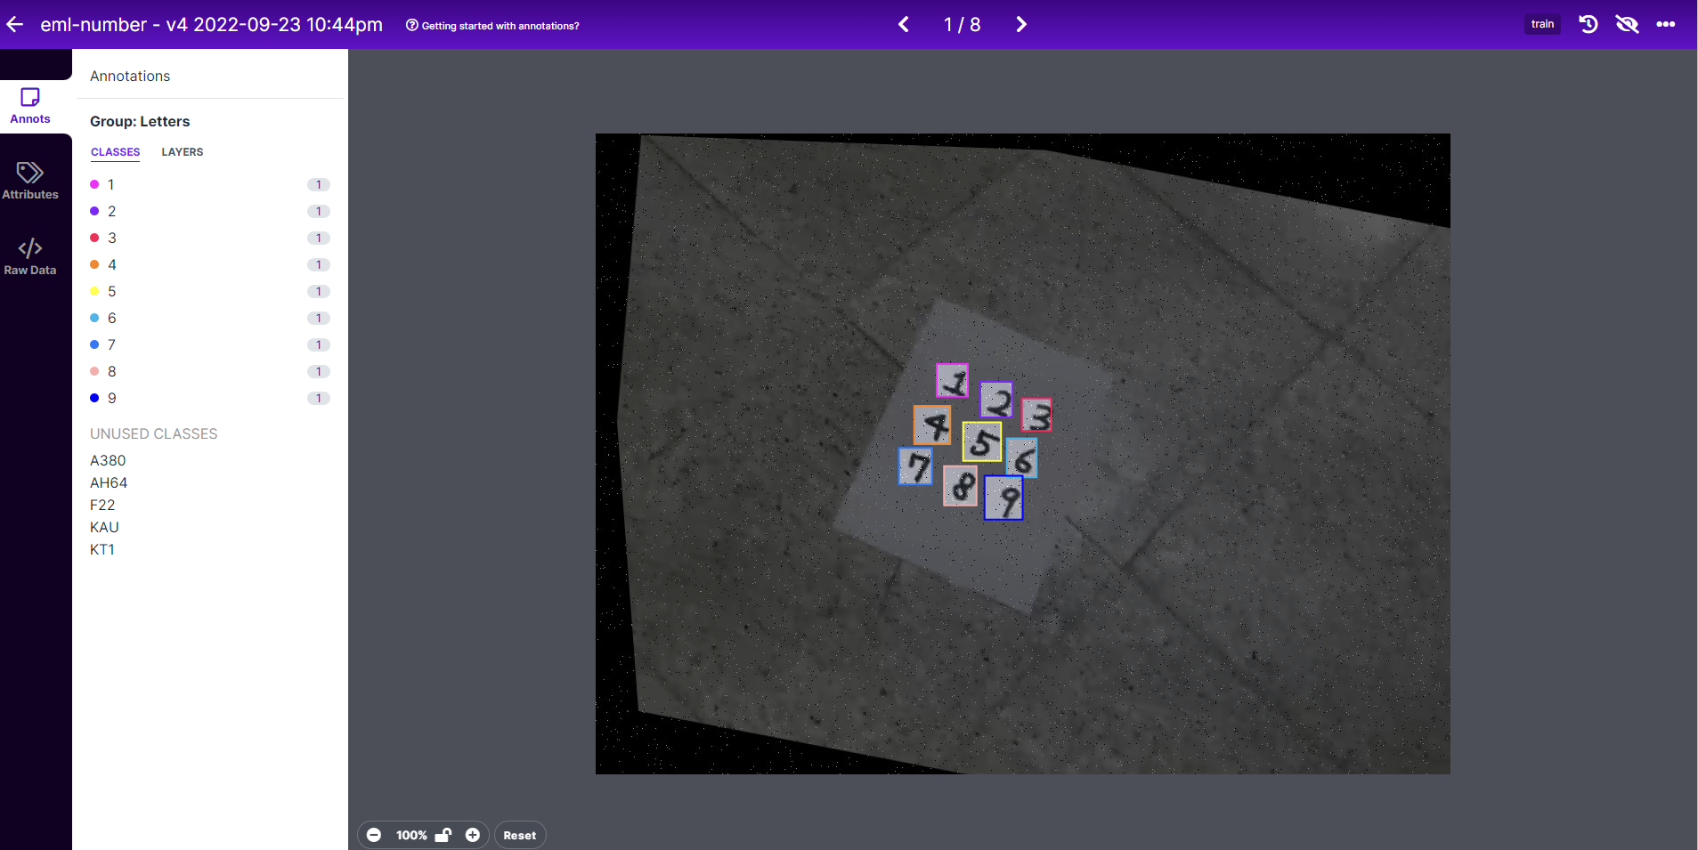
1. Flag Recognition Course
Step2. Flag Recognition

Slide 9
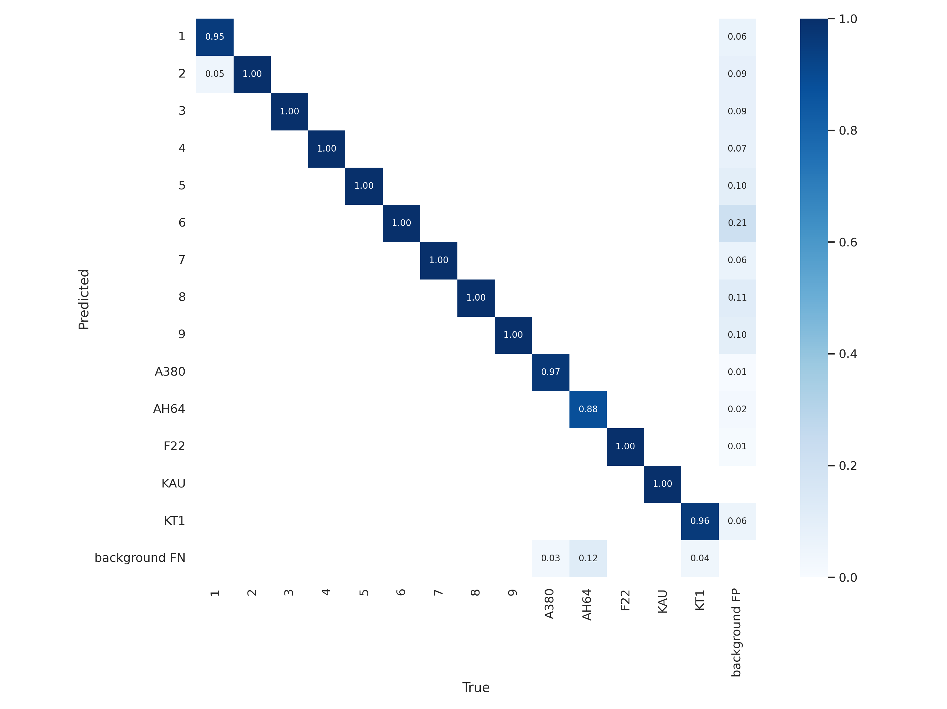

Slide 10
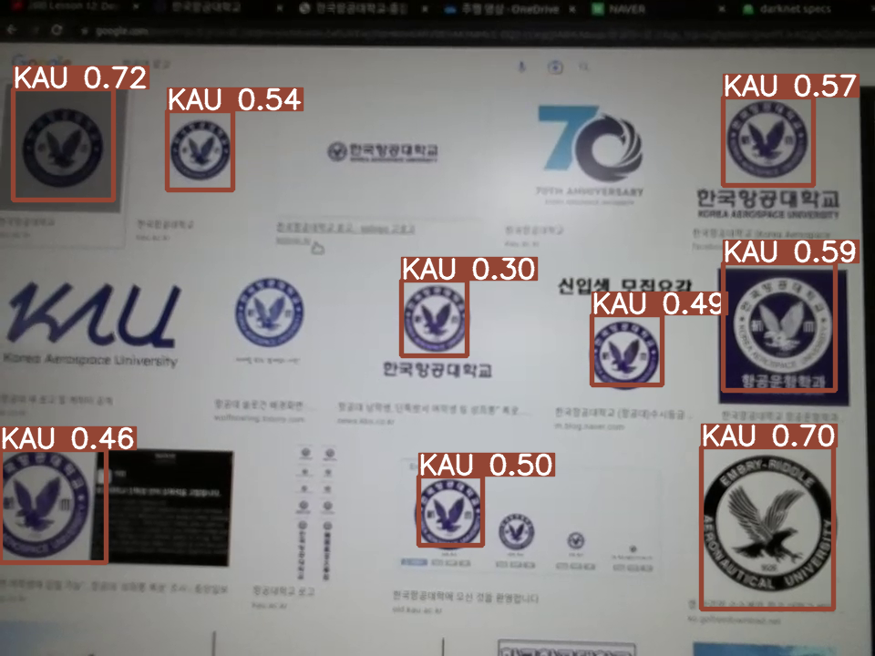

2. Tracking Course

Slide 11
2. Tracking Course

Slide 12
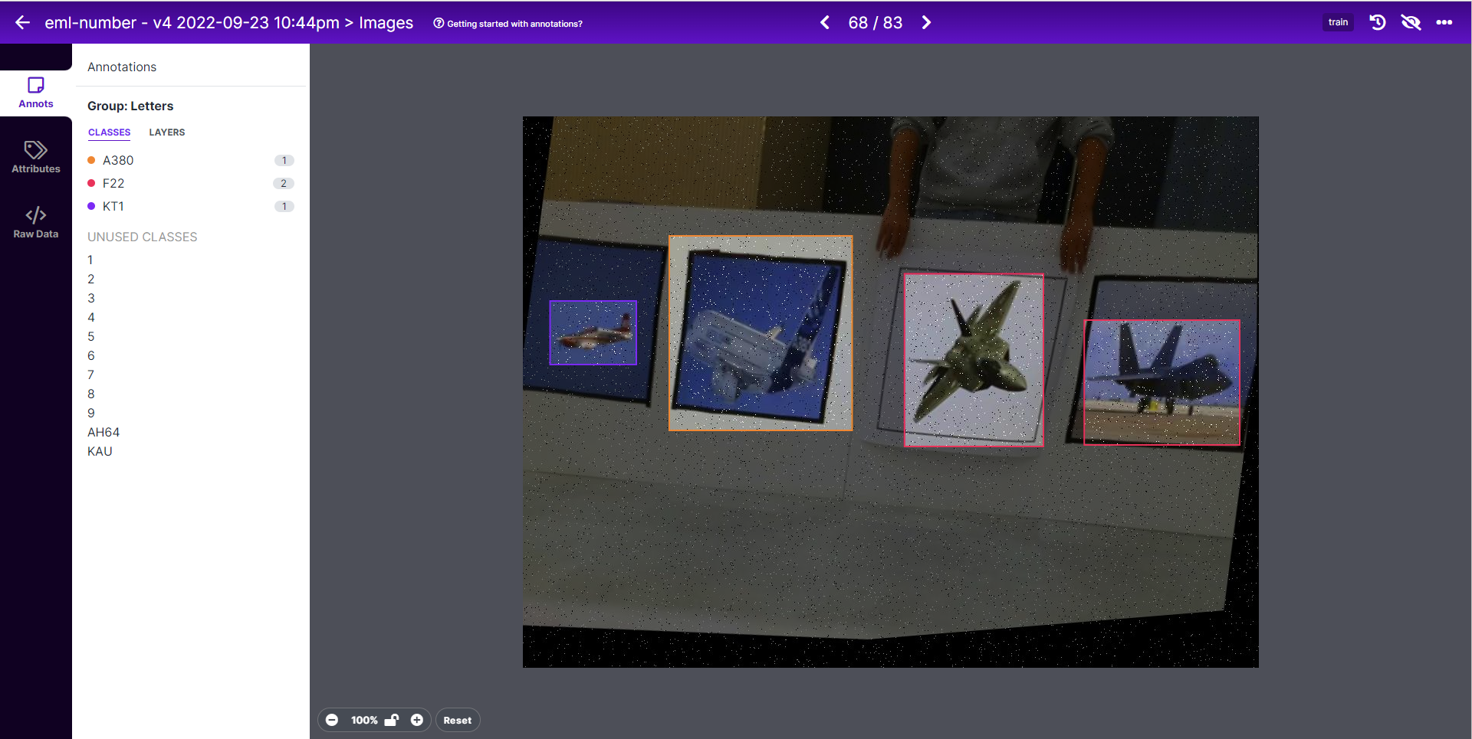
3. Landing Course
KT-1
def object_follow()
A380
AH-64
Apache
The Final Landing Site!!
F22

Slide 13
3. Landing Course
KT-1
A380
AH-64
Apache
F22

Slide 14
Thank you! We are Emergency Landing
Emergency!!!

